Slide 1
Word2Vec

Slide 2
ABOUT ME
Introduction
Use case
Model structure
Train data
Numpy implement
Gensim sample
References
LG/gl93678

Slide 3
Introduction
Word Embedding
methods to represent words in a numerical way
One-hot
CBOW(Continuous-bag-of-words)
SG(Skip-grams)
……

Slide 4
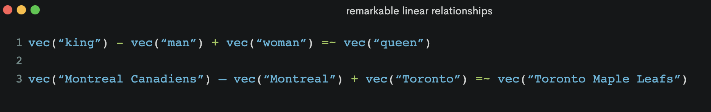
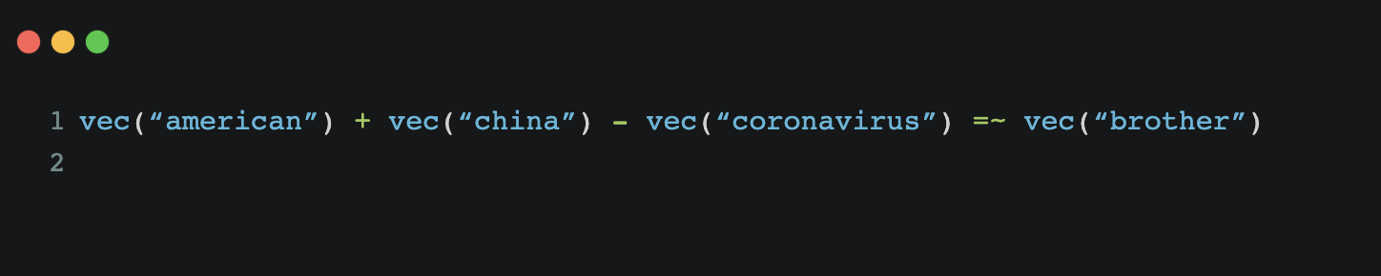
Use case
Notes:
vec(“king”) - vec(“man”) + vec(“woman”) =~ vec(“queen”)
vec(“Montreal Canadiens”) – vec(“Montreal”) + vec(“Toronto”) =~ vec(“Toronto Maple Leafs”).

Slide 5
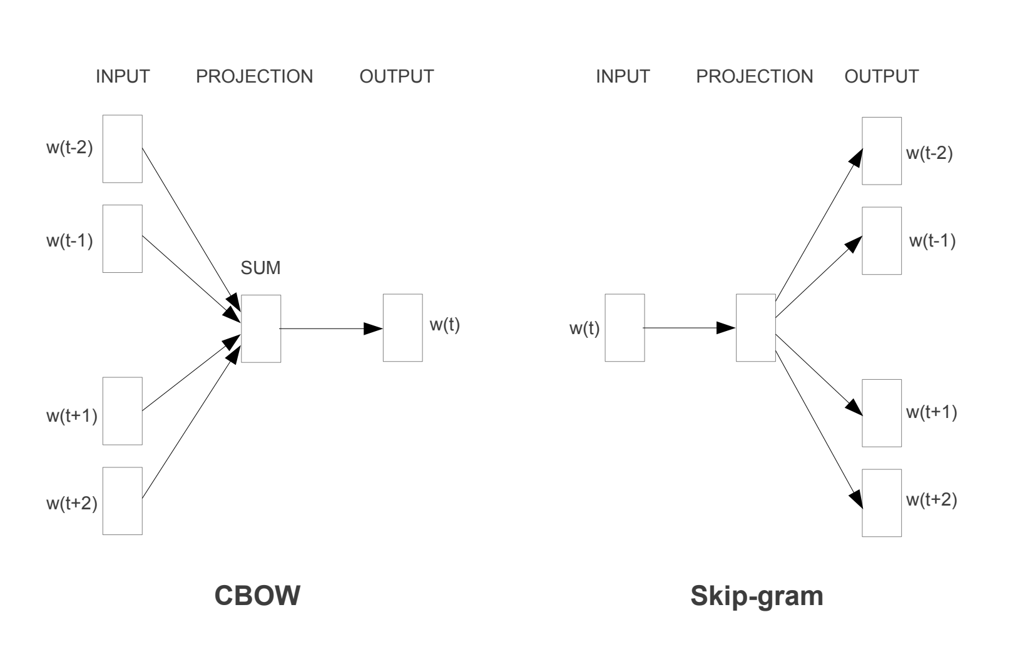
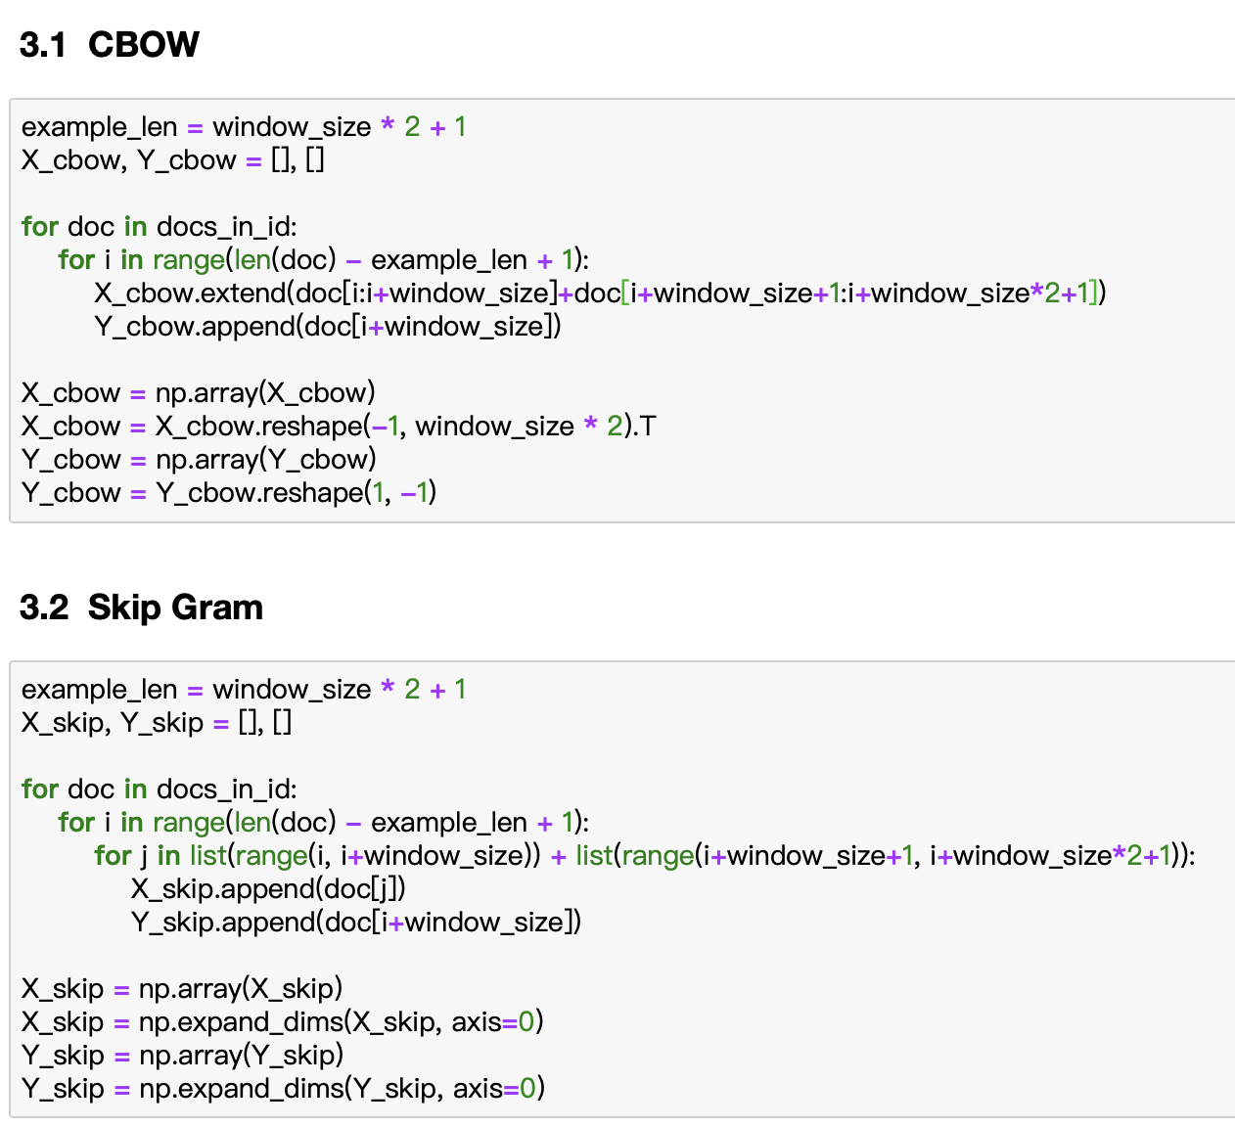
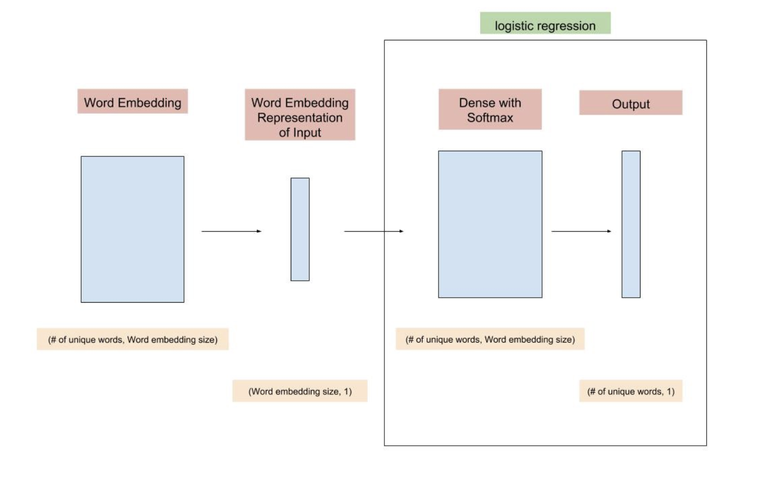
Model structure

Slide 6
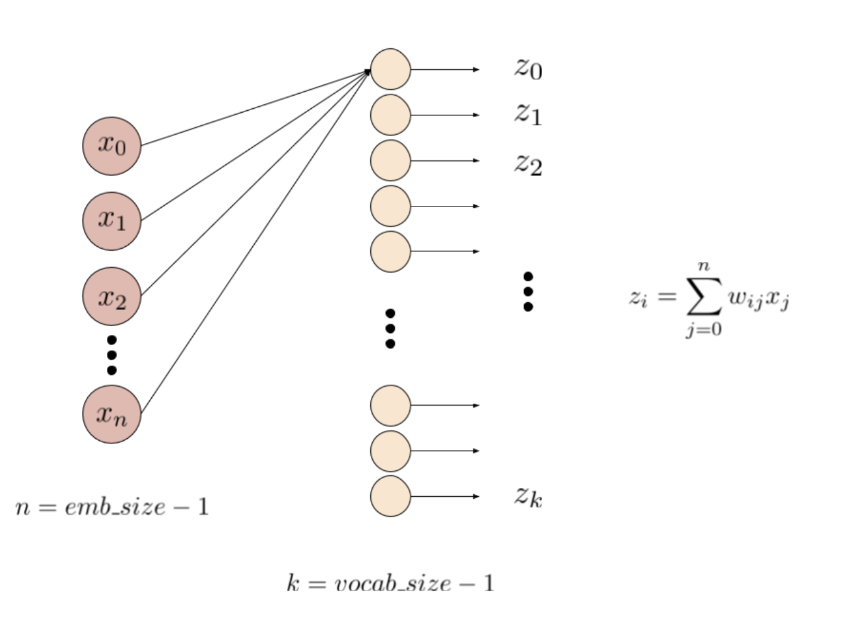
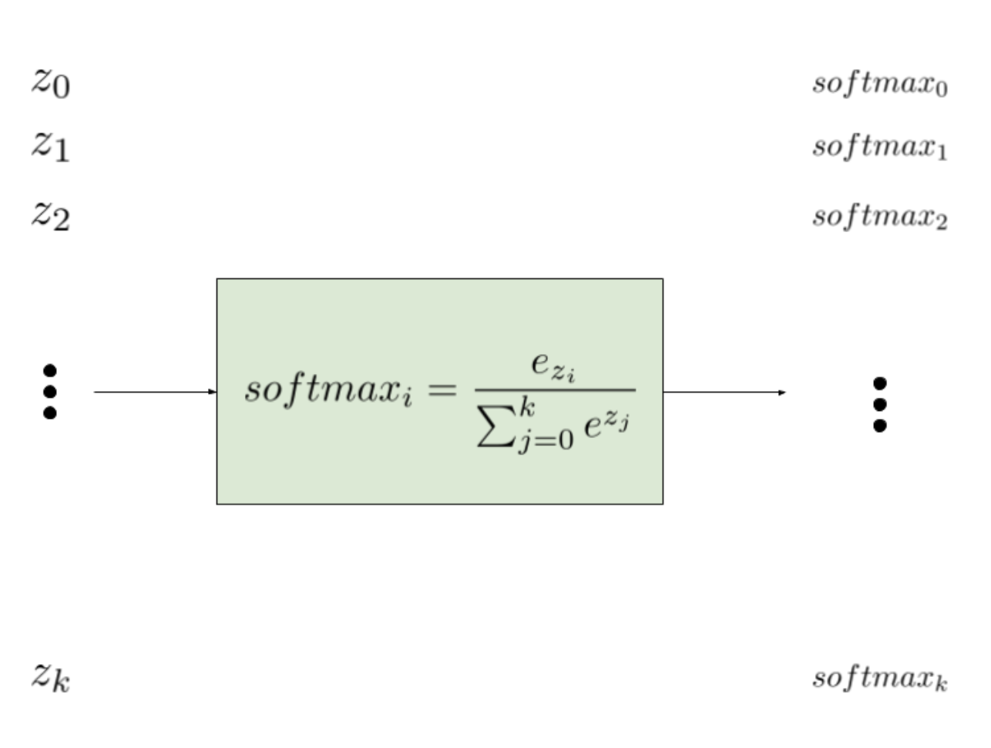
Model structure

Slide 7
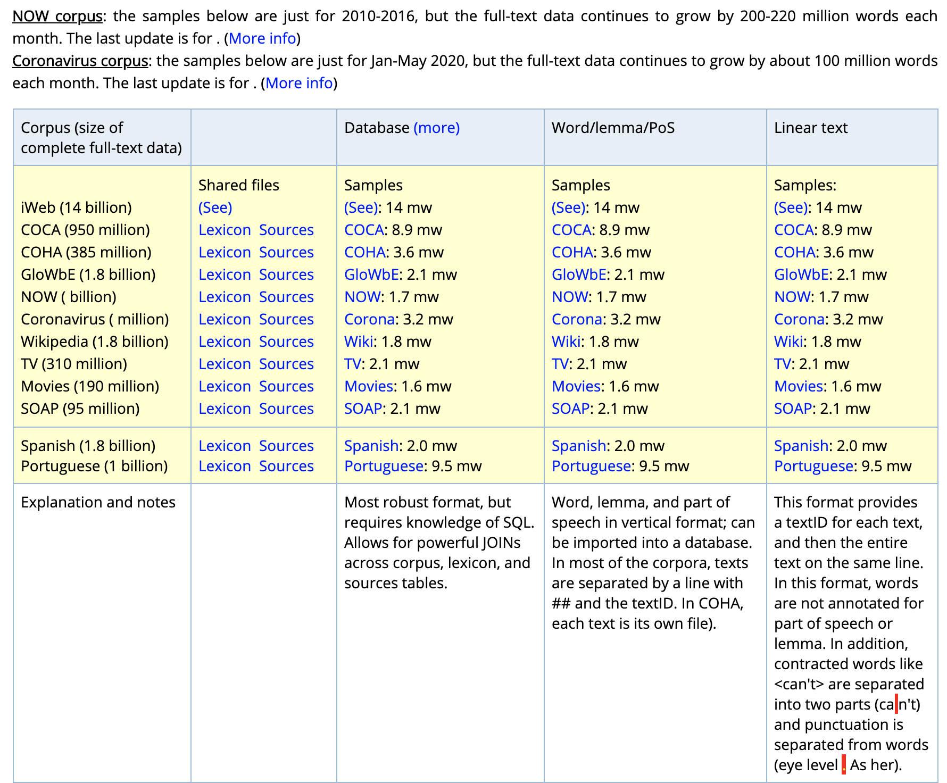
Train data
https://www.corpusdata.org/formats.asp
https://www.corpusdata.org/corona_corpus.asp

Slide 8
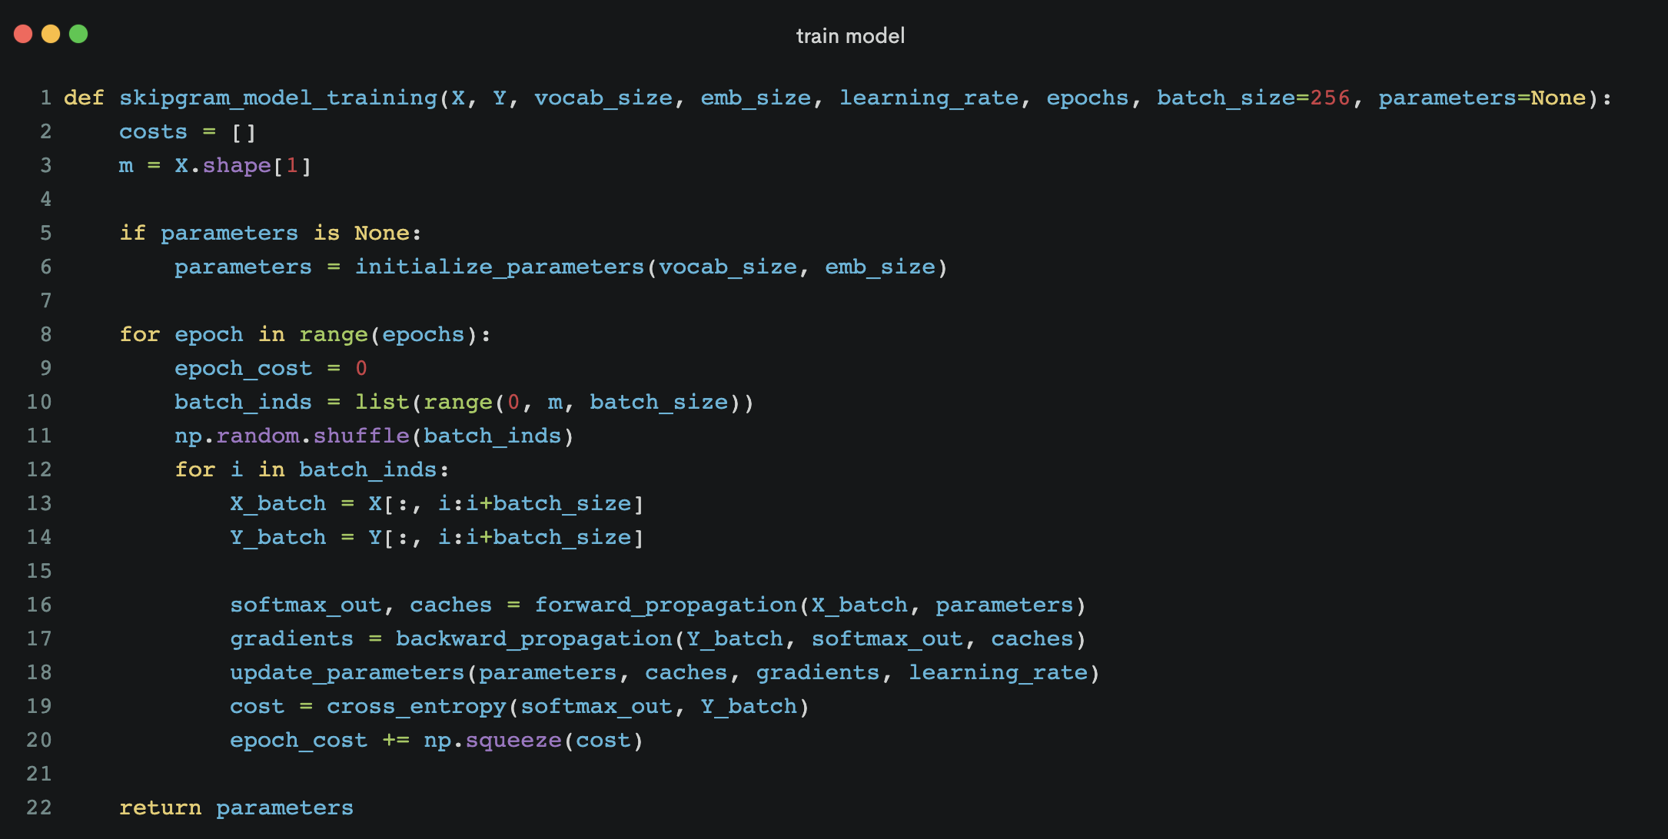
Numpy implement

Slide 9
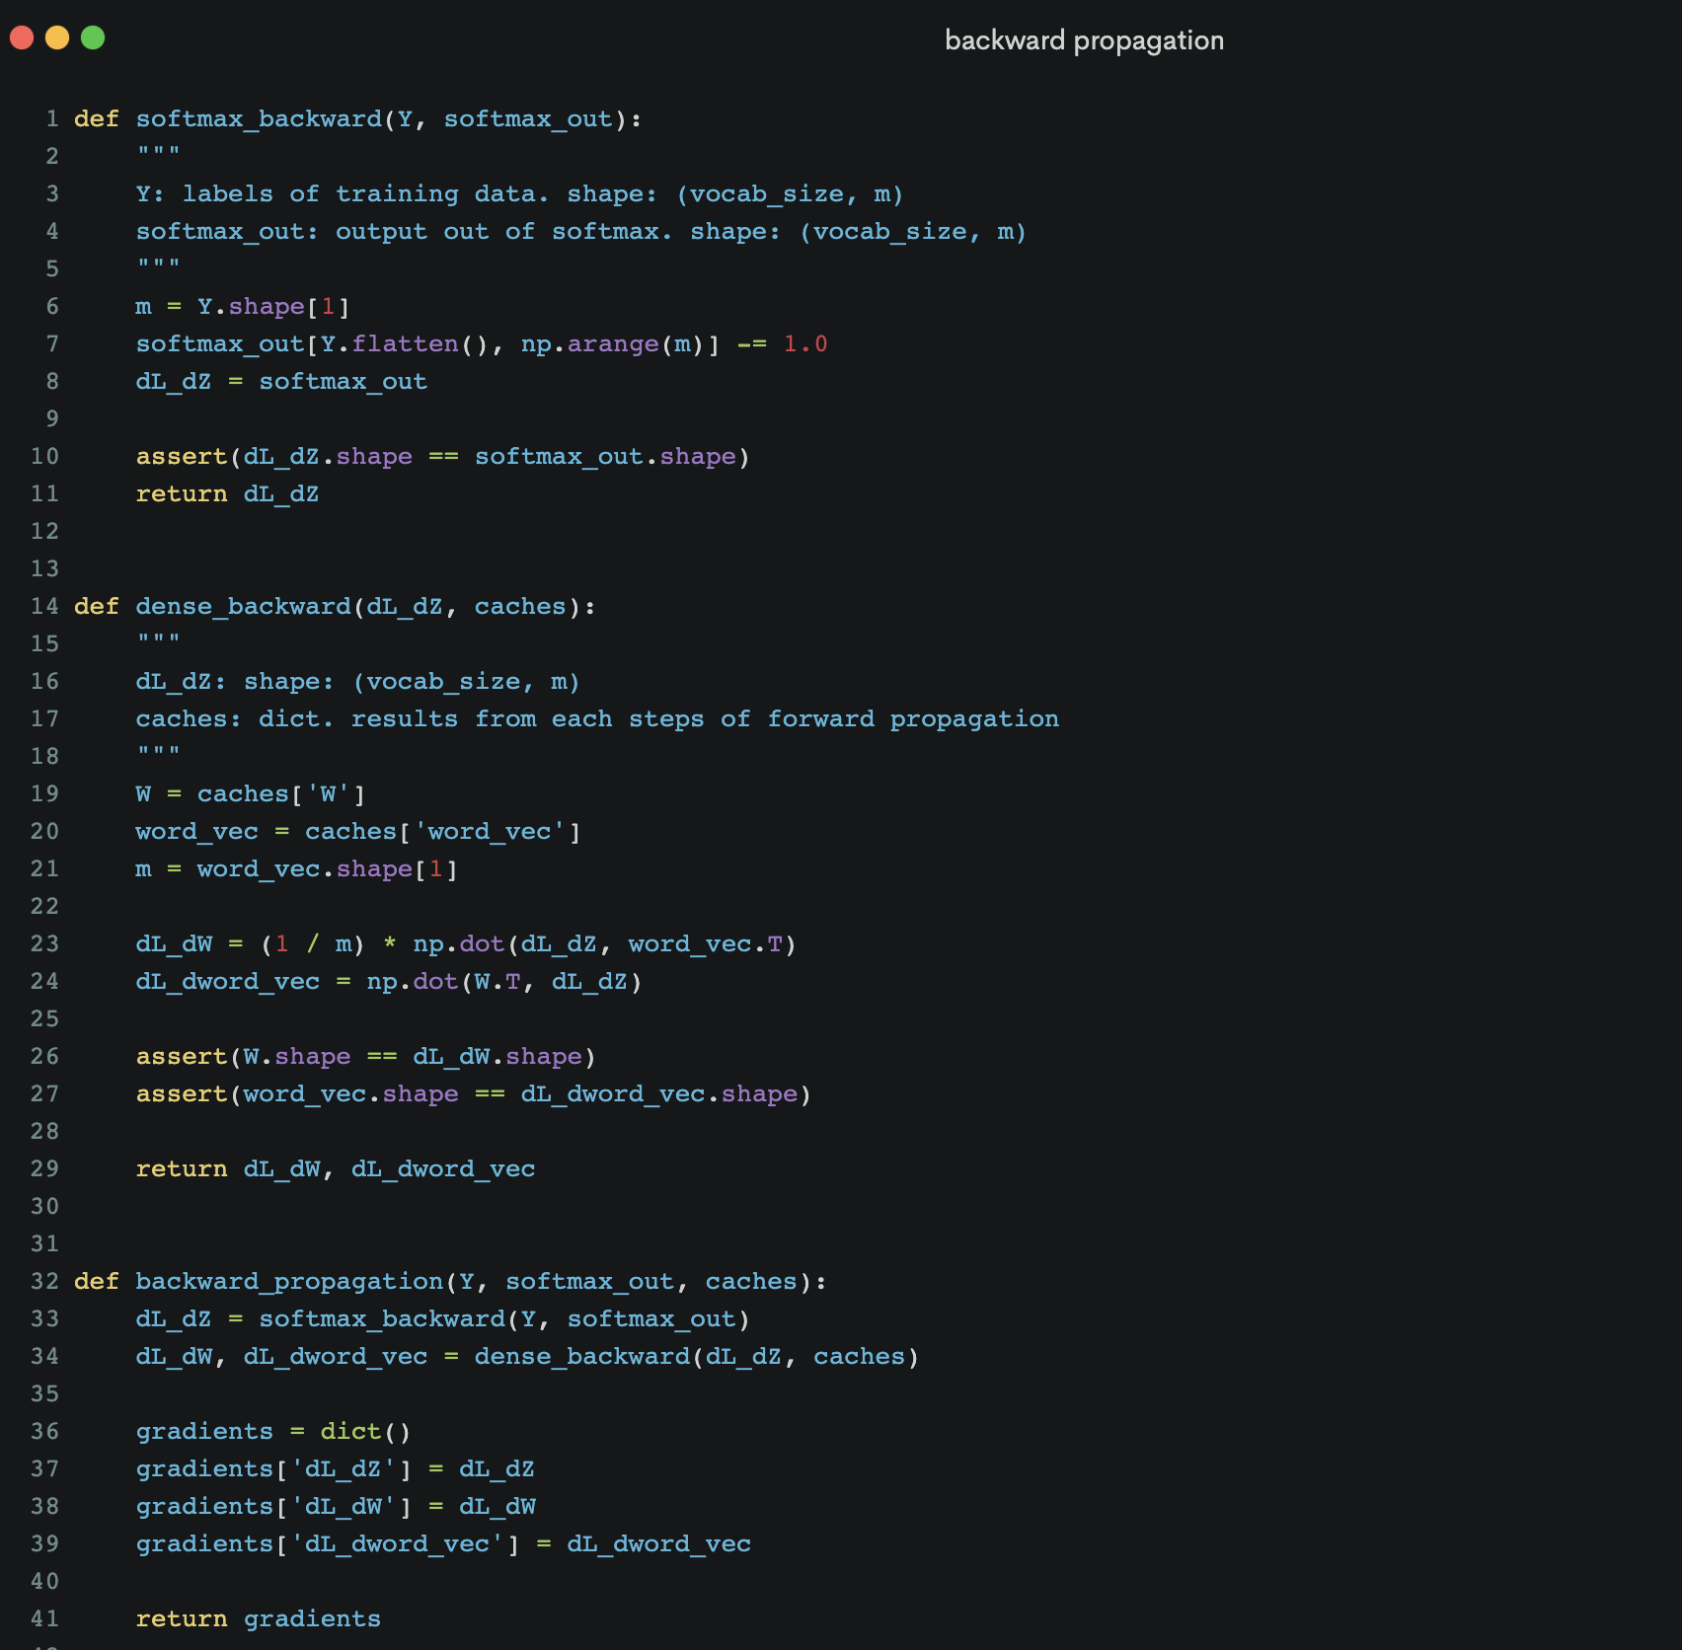
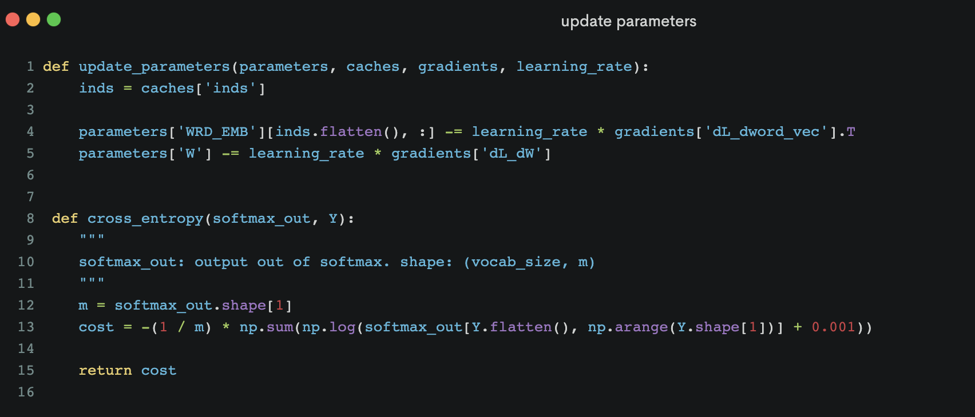
Numpy implement

Slide 10
Numpy implement

Slide 11
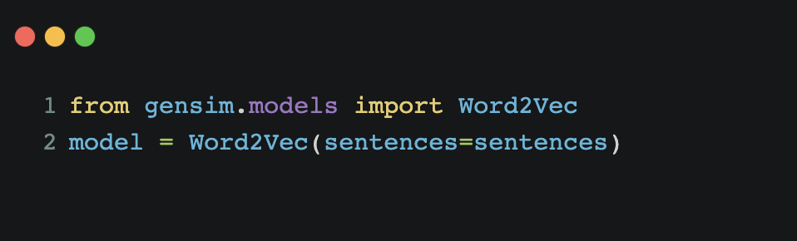
Gensim sample

Slide 12
References
[Word2vec from Scratch with NumPy](https://towardsdatascience.com/word2vec-from-scratch-with-numpy-8786ddd49e72)
[gensim Word2Vec Model](https://radimrehurek.com/gensim/auto_examples/tutorials/run_word2vec.html#sphx-glr-download-auto-examples-tutorials-run-word2vec-py)
[Efficient Estimation of Word Representations in Vector Space](https://arxiv.org/pdf/1301.3781.pdf)

Slide 13
Q&A

